Slide 1
A human way to take attendance and get feedback
Harris Schrick
Advisor: Doina Caragea

Slide 2
Intentions
Work
School
Out of office meetings
Charity 5k’s/races
Lunch meetups
Corporate Talks
Work Softball/Sports team meetups
Large outdoor gatherings
Field trips
Museum Visits
Sports
Volunteering
Plays
Educational Speeches/performances
Other External assignments

Slide 3
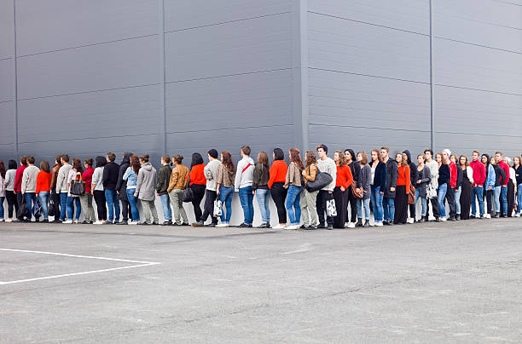
ONE BORING PROBLEM
What is worse than driving a long way to an event outside of work or school and instead of jumping right in you have to stand in a long cue to check in.

Slide 4
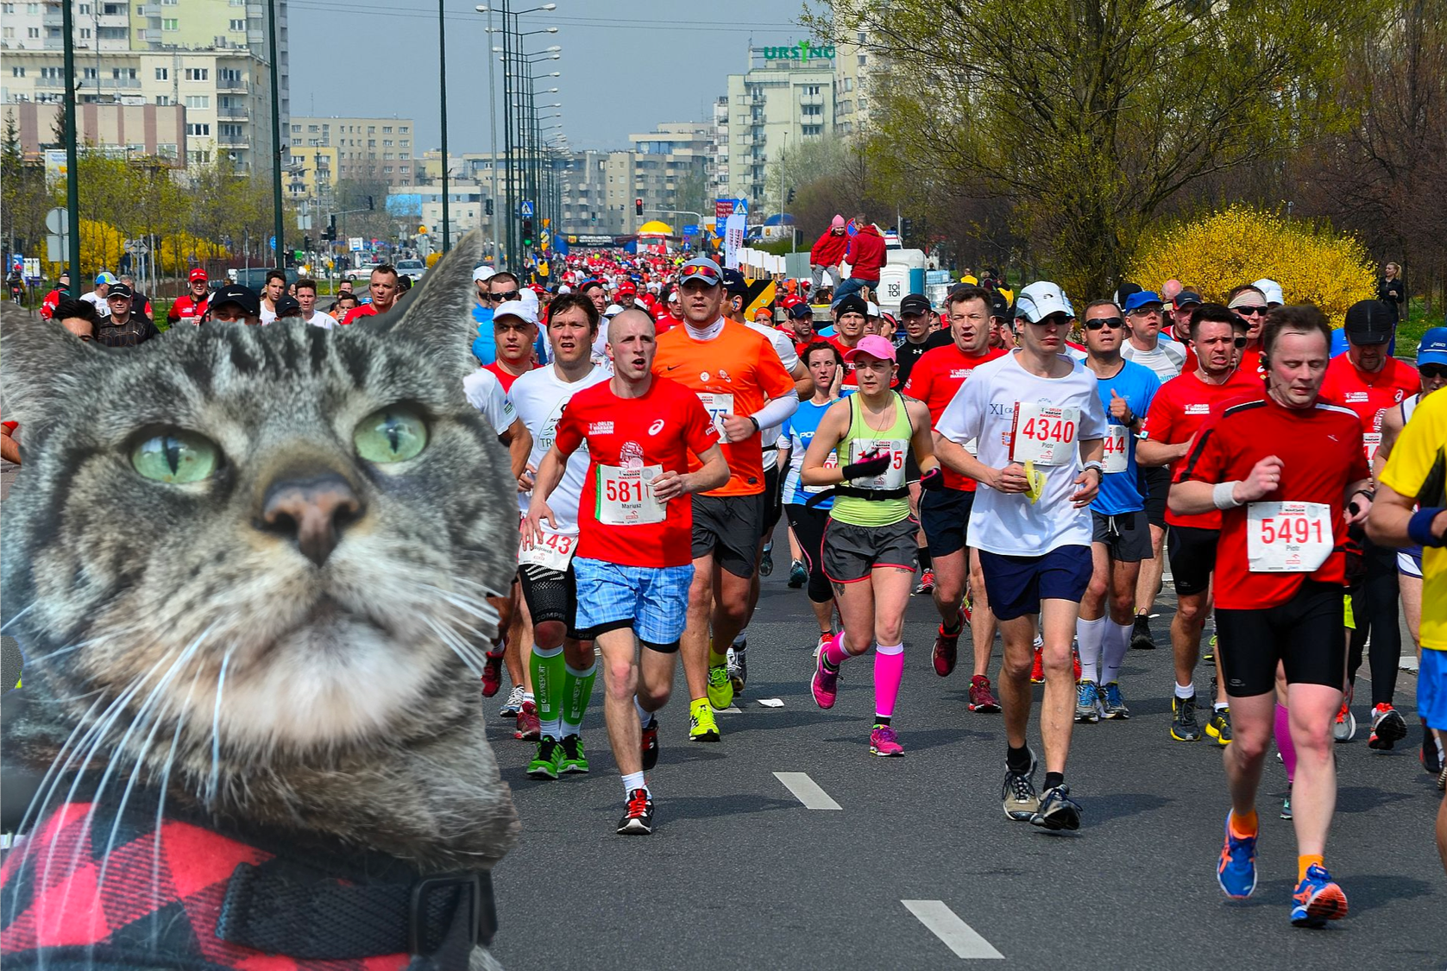
#SELFIEHERE

Slide 5
The Solution
Step 2
Upload to twitter with given tag and
Comment on event
Step 1
Step 3
Superior simply types in given tag and timespan of event on selfiehere program
Take a selfie with the event in the background

Slide 6
Step 4
SelfieHere will then:
Grab users tweet data within specific time period.
Take attendance down to the minute and second of tweet.
Verify a photo was taken
Compile attendee’s separate comments and perform a sentiment analysis about the event.
Display the top 3 most popular comments about the event.

Slide 7
Step 5
Reap your rewards:
Receive attendance/extra credit points from school.
Receive pay/benefits from work.
Analysis shows school/work that event is either worthwhile or not for future planning.

Slide 8
Base Functionality
Time constrained
data gathering
Ability to take attendance
Disregards irrelevant tweets
Custom Simple Sentiment
Analyzer
Custom Data Dump
Clean UI

Slide 9
Stretch Goals
Create Reactive UI
Refine/Advance
Sentiment Analyzer
iOS functionality
Basic Login/
Database for superior
Build API

Slide 10
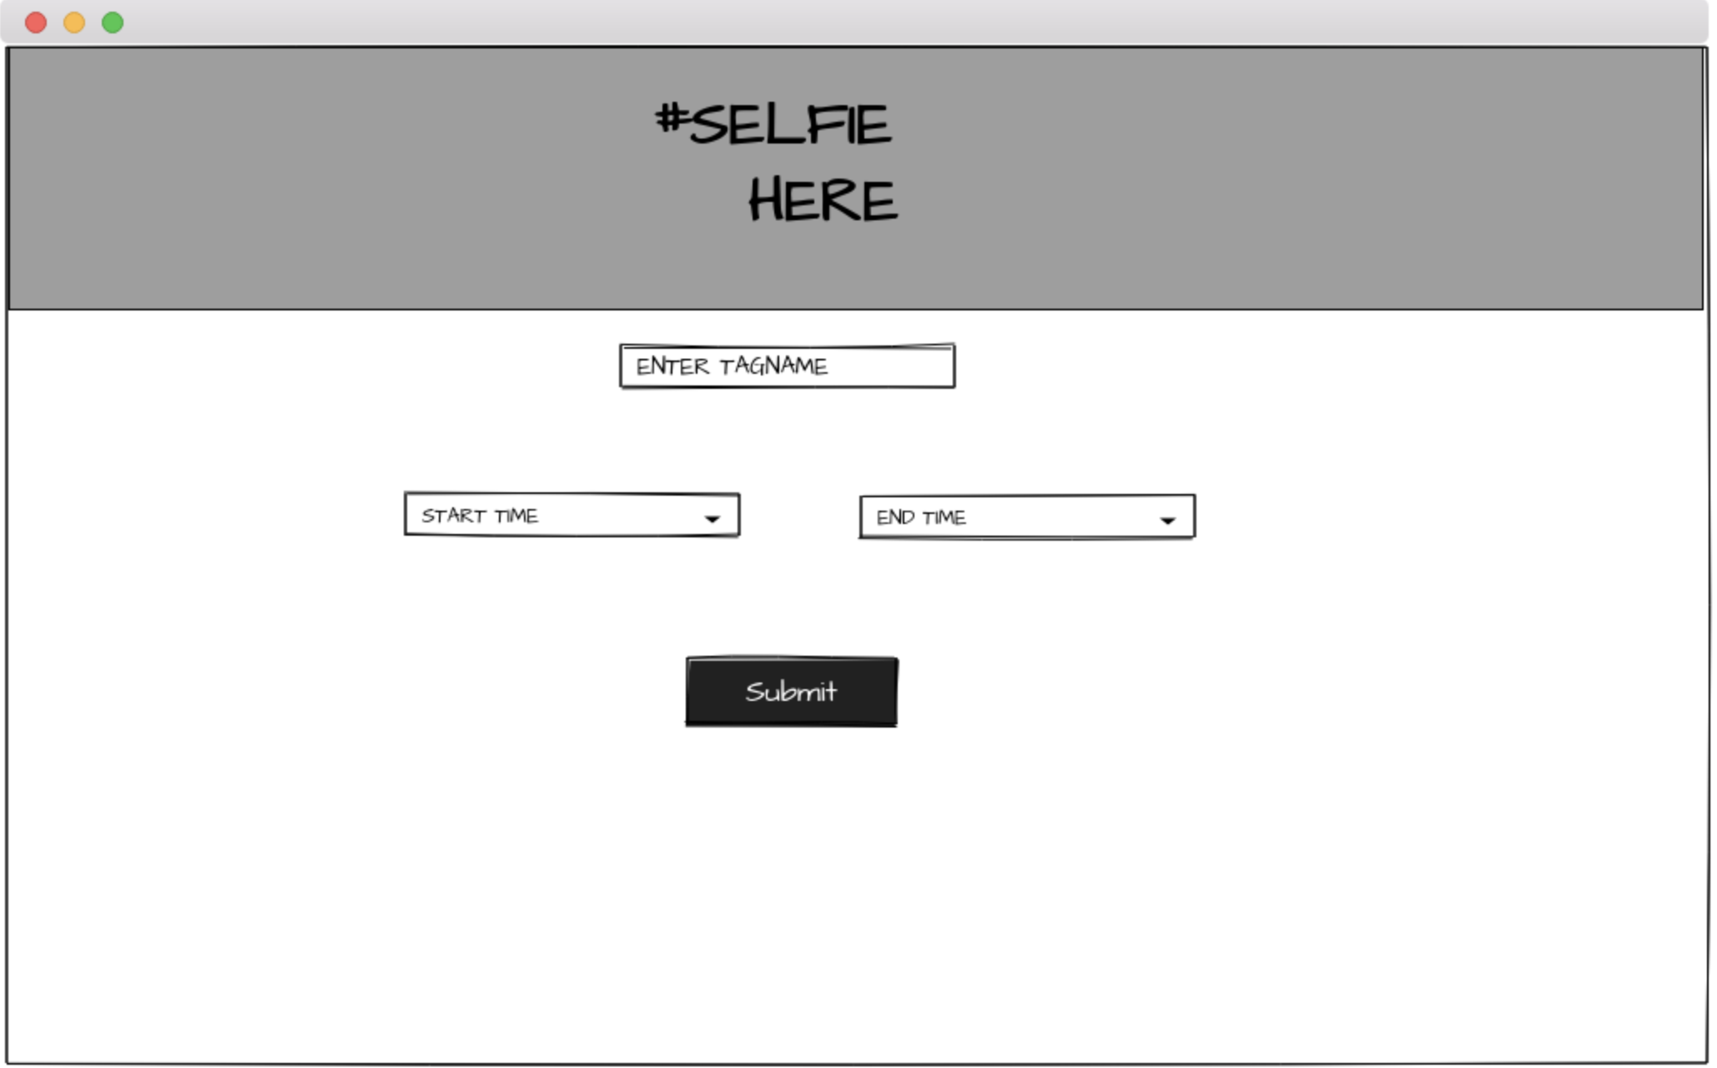
Mockups – page 1

Slide 11
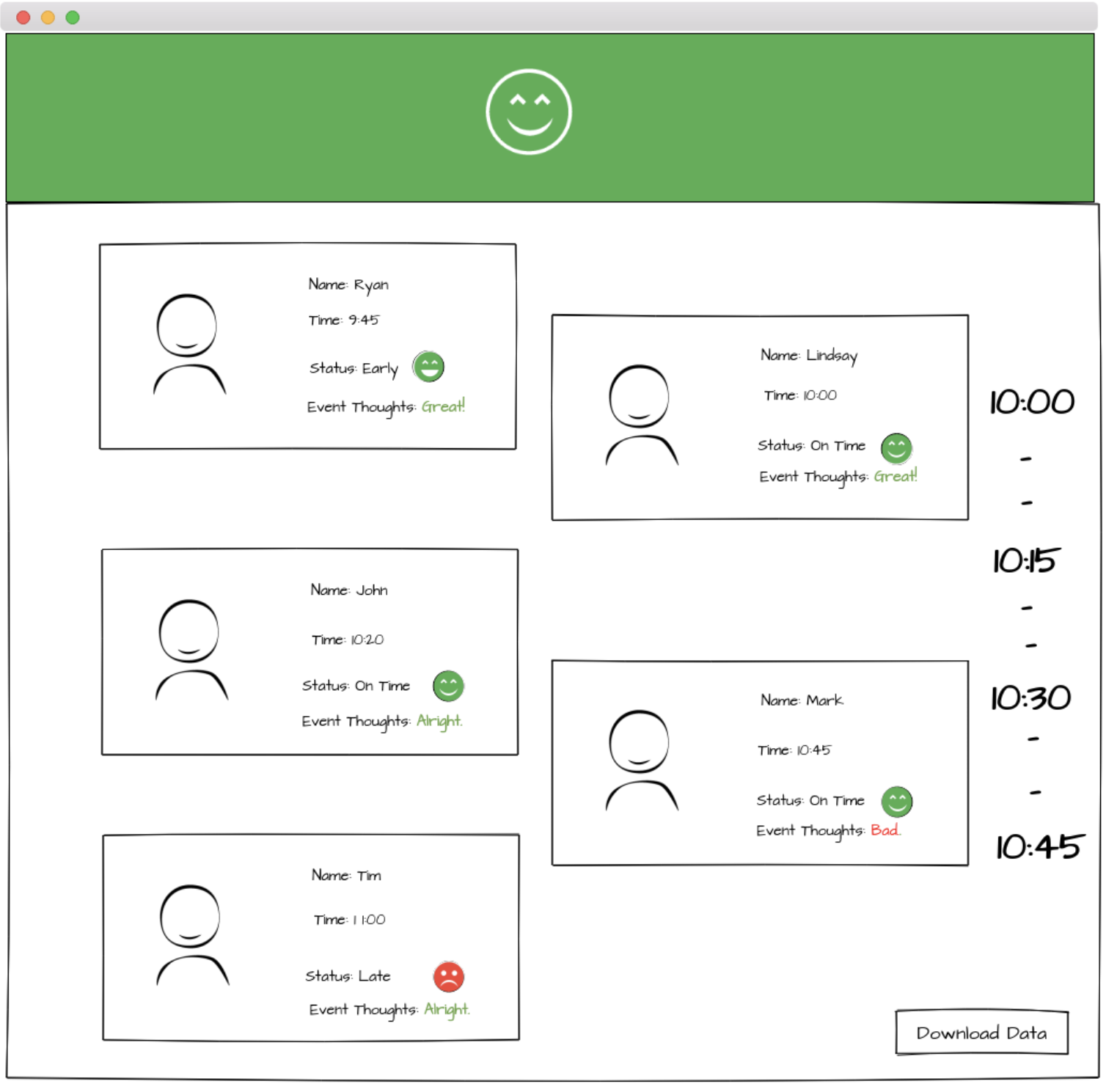
Mockups – page 2

Slide 12
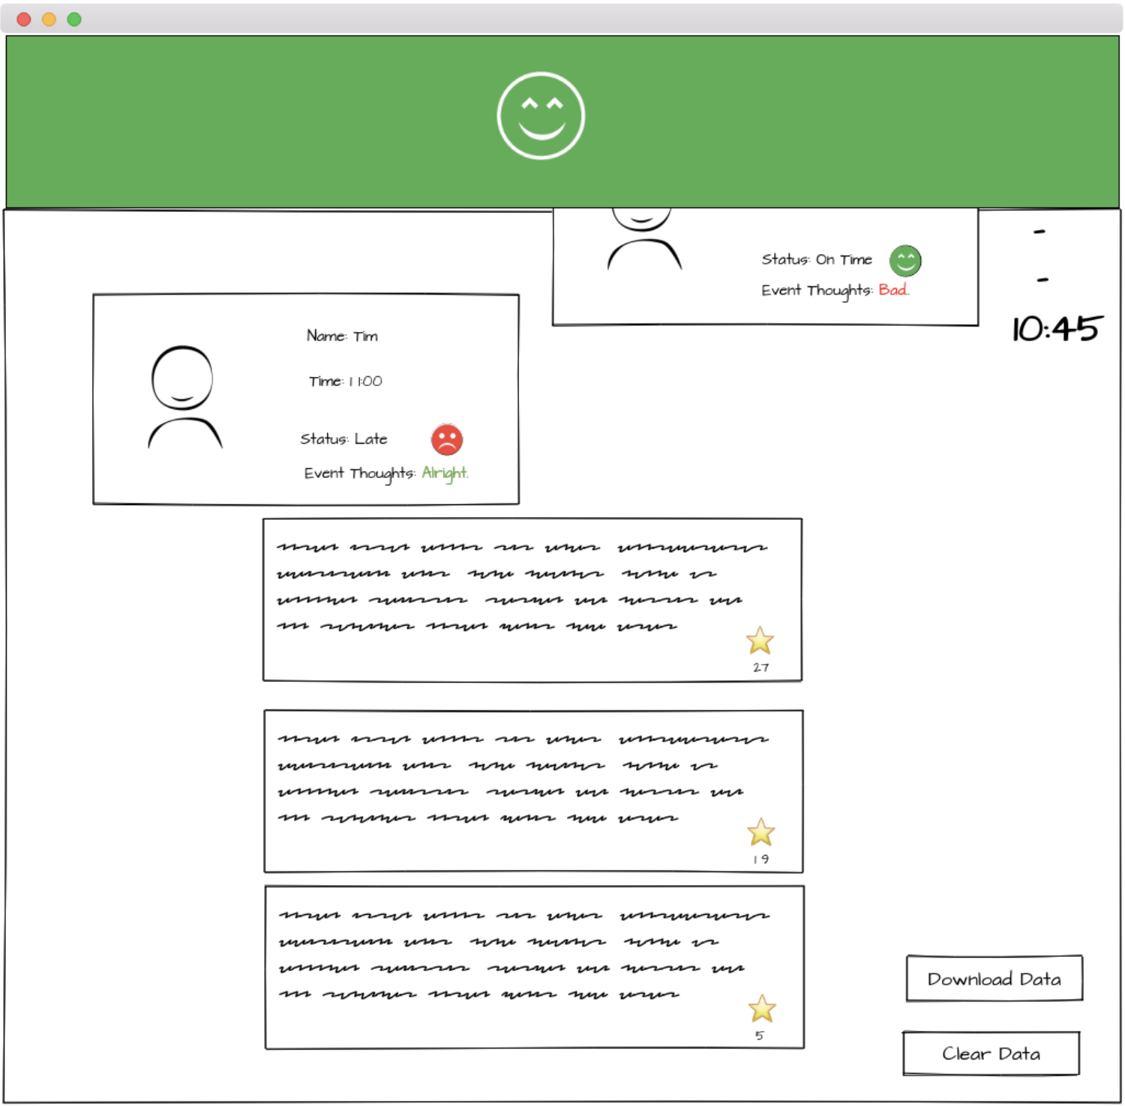
Mockups – page 3

Slide 13
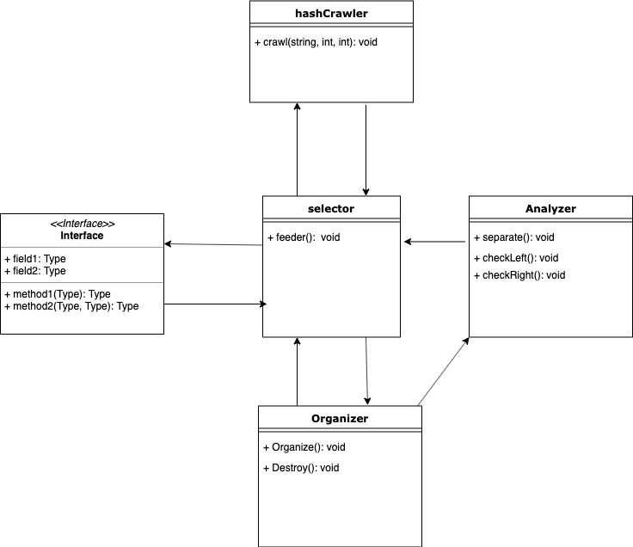

Slide 14





Required and stretch Tools

Slide 15
Timeline
August
October
Get Idea and advisor
Finish data manipulation
Take Attendance
Half done analyzer
Basic UI done
September
November
Refine Idea
Make this presentation
Make crawler to collect data
Finish/refine analyzer
Clean up UI
Stretch goals
December
Tweak
Present

Slide 16
Progress
Design
20%
Planning
50%
Code
12%
Testing
2%

Slide 17
Questions!

